Slide 1
Web Technology
Mini Project
Guide To Bangalore

Slide 2
Introduction
We have designed a website for the tourist visiting the Green City Bangalore. We have named our Website as The Bangalore Guide. We are here by looking forward to make the tourist aware about all the activities and places they can visit to make themselves comfortable at Bangalore. We have provided the information regarding all aspects as well the directions to that particular place making the website user-friendly.

Slide 3
The main objectives
TOURISM HOT SPOTS
FUN TIME
RESTUARANTS
SHOPPING

Slide 4
Technologies useD
HTML
CSS
JAVASCRIPT
PHP
BOOTSRAP

Slide 5
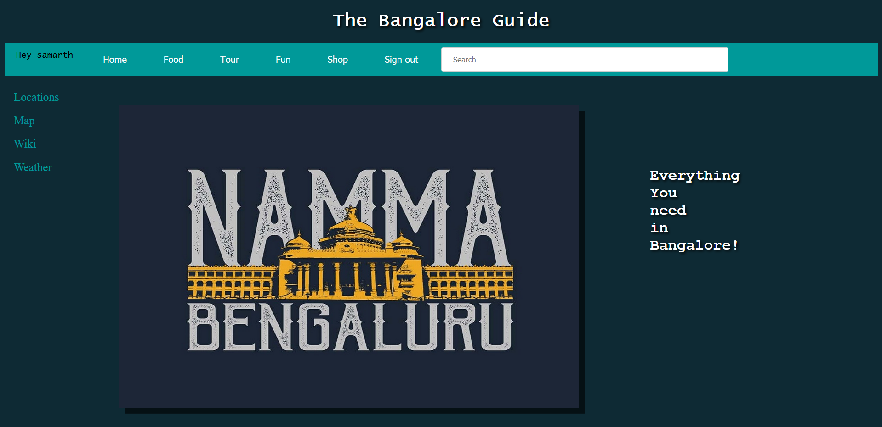
The Preview of our Homepage

Slide 6
Future enhancements
Option to review and rate.
Increase the number of locations.
Location based filtering.
Better interactive interface.

Slide 7
Thank You !
Team Members :
Samarth M 01FB16ECS335
Saahil Jain 01FB16ECS321
Sachin S 01FB16ECS323

